Slide 1
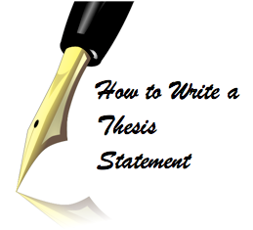
Thesis Statements
Writing Center Workshop
K. Yegoryan

Slide 2
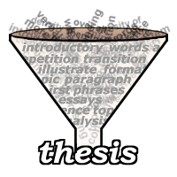
A thesis statement is…
A sentence that goes at the end of your introductory paragraph. IT IS THE LAST SENTENCE OF INTRODUCTION
The main idea of the whole essay.
A debatable statement, the author’s argument /opinion.
It is usually 1 sentence or 2 max.

Slide 3
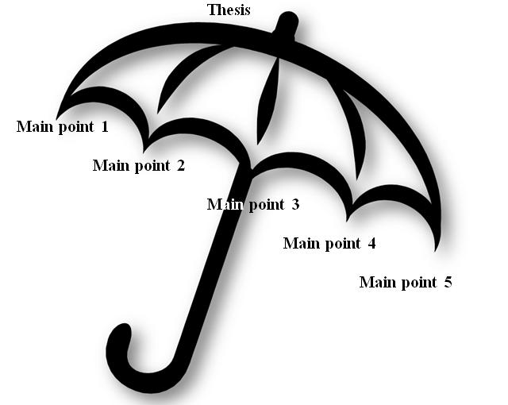
What does a thesis statement do?
A thesis statement…
provides the point you (the authors) want to prove.
presents your argument in a concise form.
can provide the opposite point of view.
gives the structure your essay will follow; it is
like a roadmap that tells what to expect next.
Thesis is also said to be like an umbrella that covers all the main ideas of the essay.

Slide 4
Are there different types of thesis statements?
YES
Open, Complete and Fully-developed
An Open Thesis only states the writers argument (it does not contain the body points.)
i.e. Everyone should drive a hybrid car.
A Complete Thesis states the writer’s arguments and also includes the supportive points (the body points.)
i.e. Everyone should drive a hybrid car because they pollute less, they get better mileage, and they help reduce gasoline costs.

Slide 5
A Fully-Developed Thesis includes the counter argument, the writer’s argument, and the supportive points (the body points.)
A sample Fully-Developed Thesis:
-------------------------------------------------------------------------------------------------------------------------------------------------------------------------------------------------------------------------------
Although counter argument, actually your argument because 1st supporting idea, 2nd supporting Idea, and 3rd supporting idea.
--------------------------------------------------------------------------------------------------------------------------------------------------------------------------------------------------------------------------------
i.e. Although some believe that hybrid cars are dangerous and may have malfunction in bad weather, everyone should consider a hybrid car because they pollute less, they get better mileage, and they help reduce gasoline costs.

Slide 6
Your thesis is the foundation of your essay
The entire essay attempts to prove that your thesis is correct.
Constantly refer back to your thesis to make sure that your essay is staying on track
If you used a Complete Thesis, each of your body paragraphs should cover one of the points mentioned in your thesis.
Your body paragraphs should go in the same order as the points they cover were mentioned in the thesis.

Slide 7
What does a strong thesis statement look like?
Remember that a strong thesis statement makes a definite point.
That point should be your own opinion.

Slide 8
A Few Examples
WEAK
The Adventures of Tom Sawyer was written by Mark Twain in 1876.
Some people think that The Adventures of Tom Sawyer is Mark Twain’s best novel.
WEAK
STRONG
The Adventures of Tom Sawyer is Mark Twain’s best novel.
The Adventures of Tom Sawyer is Mark Twain’s best novel because of its use of satire, imagery, and symbolism.
STRONGER

Slide 9
An introductory paragraph with a weak thesis
Vague
Many people believe that Dominican Republic is a wonderful vacation spot. It offers great beaches with beautiful sands and lots of attractive activities for people of all ages. That’s why people from all over the world make this part of the world their favorite vacation spot. My opinion of it is not quite the same.
Weak

Slide 10
Try it!
Some people like to do only what they already do well. Others prefer to try new things and take risks. Which do you prefer? Use specific reasons and examples to support your choice.

